Slide 1
DevOPS for SCALA
Cloud Building
for Scala Entusiasts
Michele Sciabarrà
michele@sciabarra.com

Slide 2

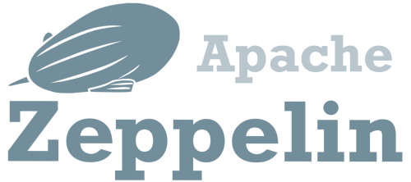



Let's do Big Data!

Slide 3
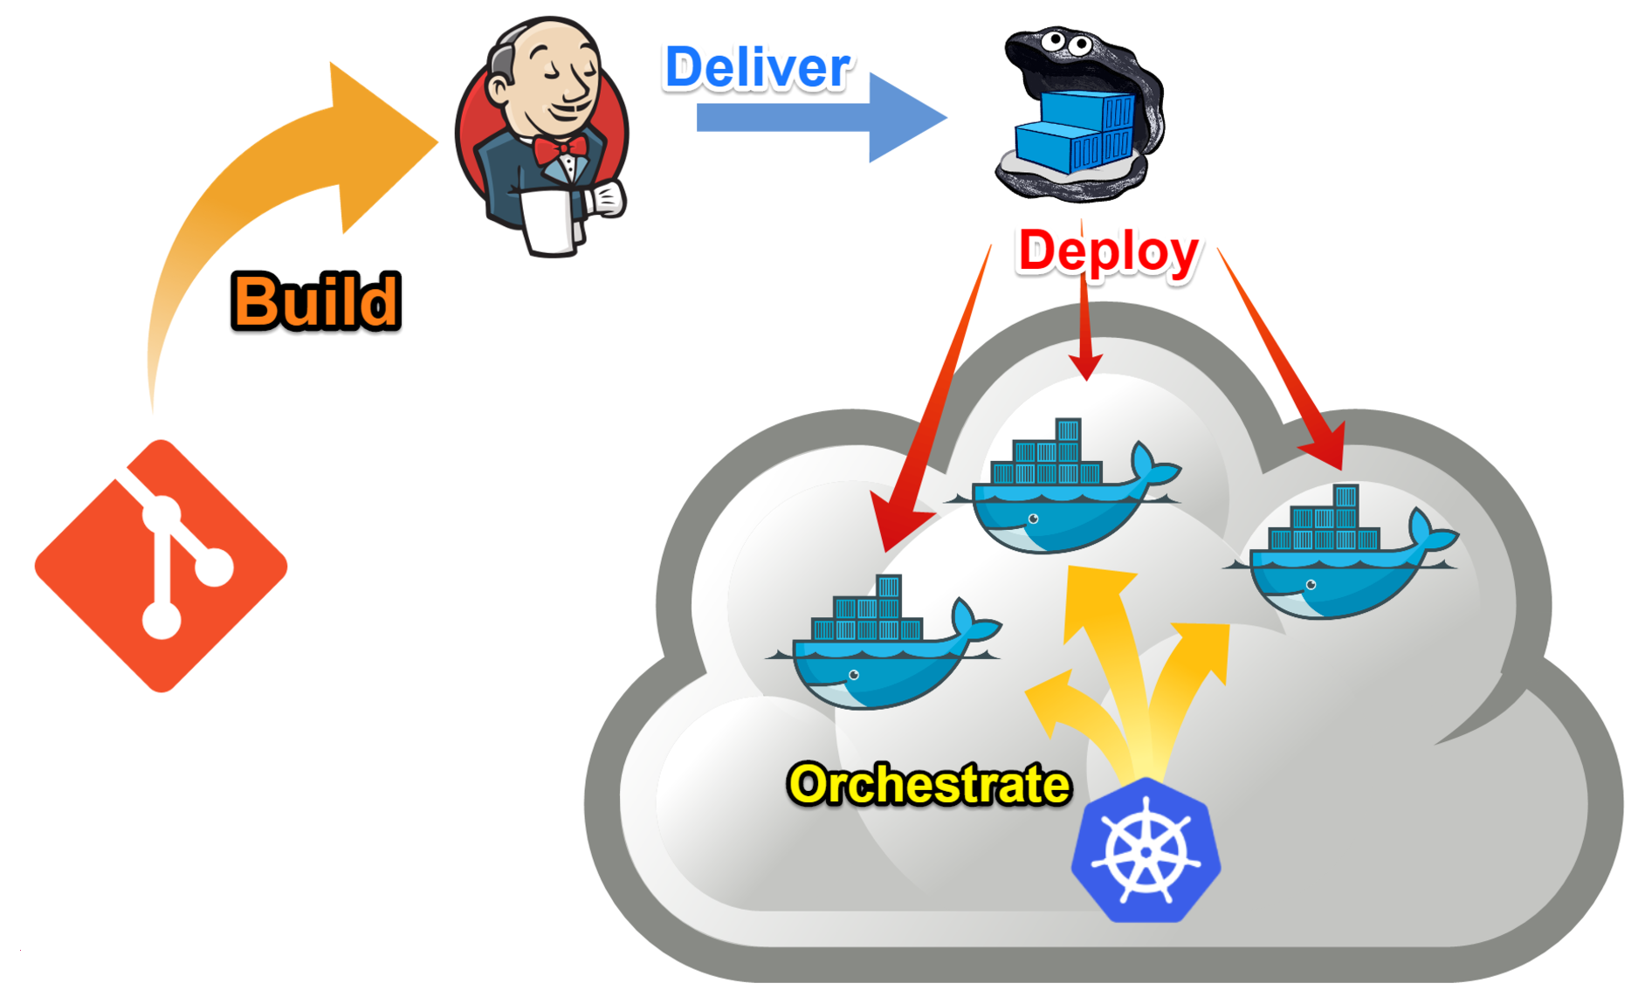

Mission Statement

Slide 4



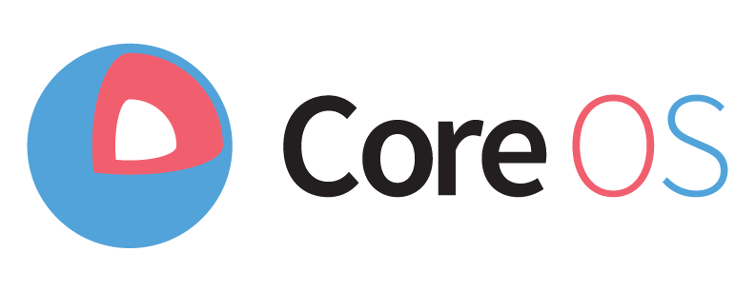
What I tried
Cloudera Distribution
DC/OS
Ambari
Tectonic

Slide 5

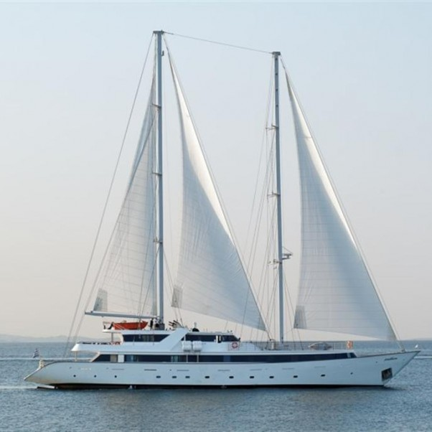
Tuning your requirements
What they sell
What you need

Slide 6
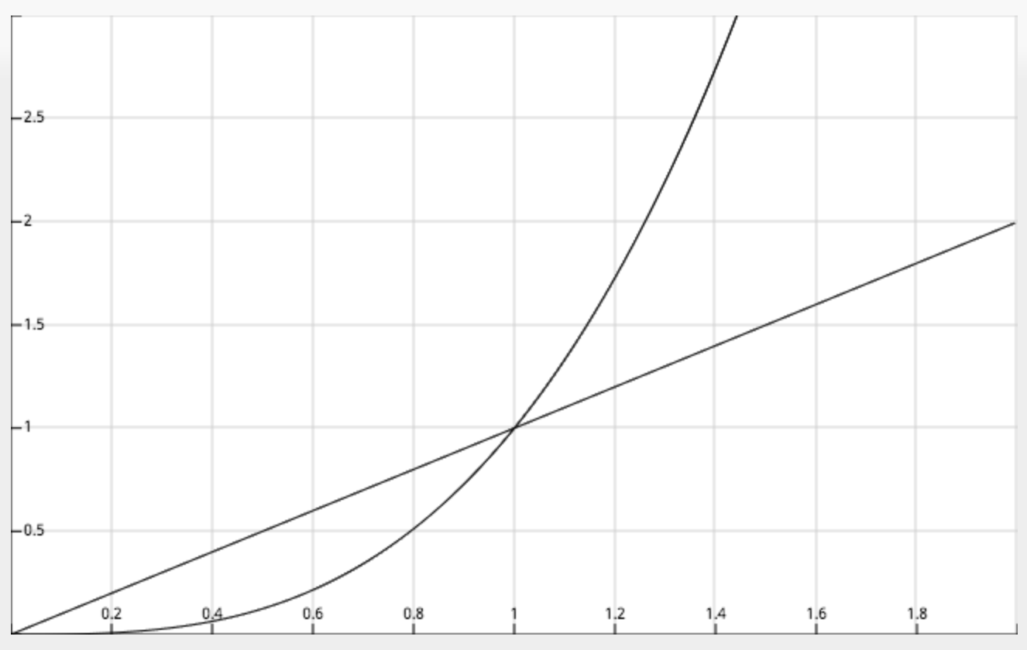
The problem with customisation
Effort
Third Part
Home Grown
Amount of Customisation

Slide 7
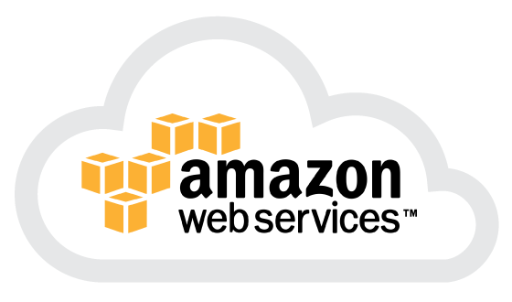
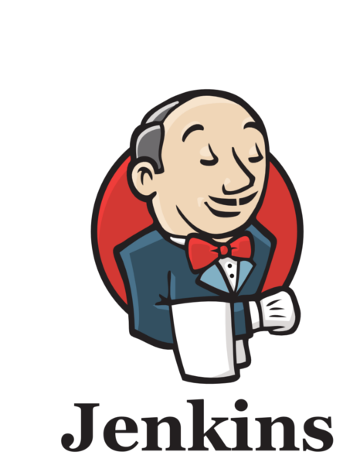
What I want
What I want:
Everything in AWS
Everything in Docker
Everything built with Jenkins
And, of course:
Easy customizability
Easy orchestration
Cheapest solution in the cloud

Slide 8
What I do NOT want
What I DO NOT want:
Hadoop
Proprietary distributions
Unused components eating precious memory in the cloud
Be stuck to one version of a component

Slide 9
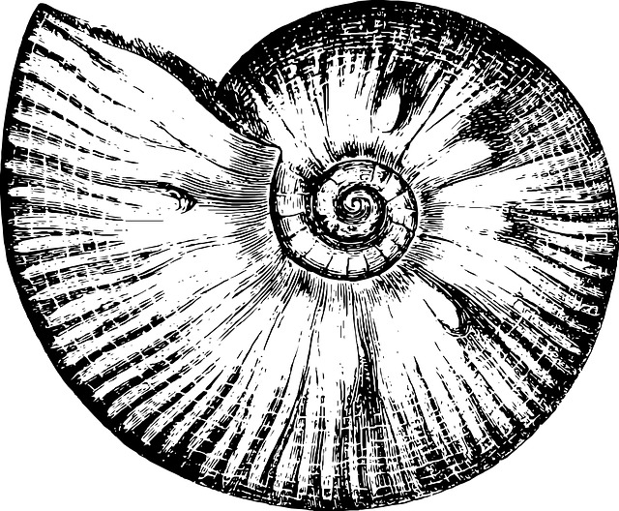

Introducing Mosaico
http://github.com
/sciabarra/Mosaico
It is not a distribution!
It is not a framework!
Open Source
It is a "starter kit" for
creating a cloud in AWS with CloudFormation
Installing Docker and Docker Swarm with Ansible
Building Images with Jenkins and SBT
Orchestrating services with Docker Compose
Ammonite

Slide 10
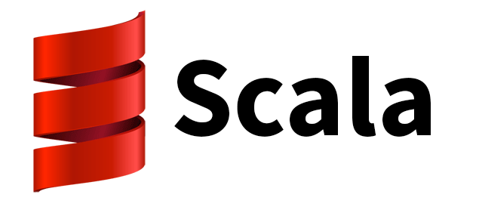
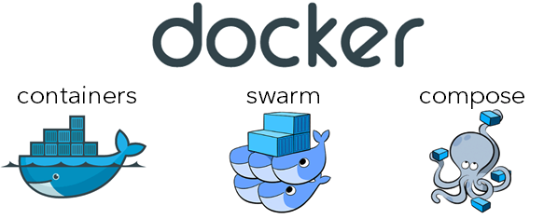
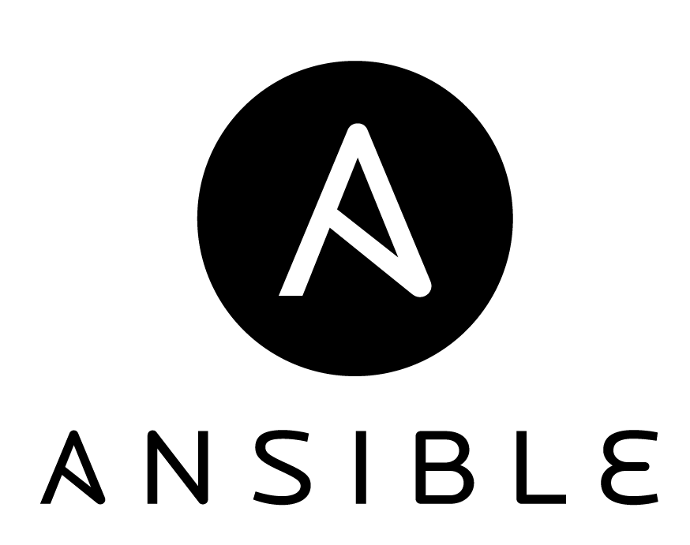
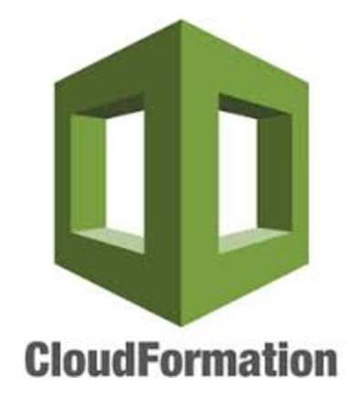
Building on the shoulders of giants
Ammonite

Slide 11

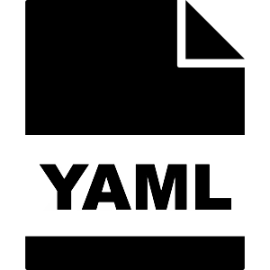

The real life of a DevOps

Slide 12


How I feel when I script with
BASH
SCALA

Slide 13



Bonus slide: Other feelings
PERL
PYTHON
RUBY

Slide 14
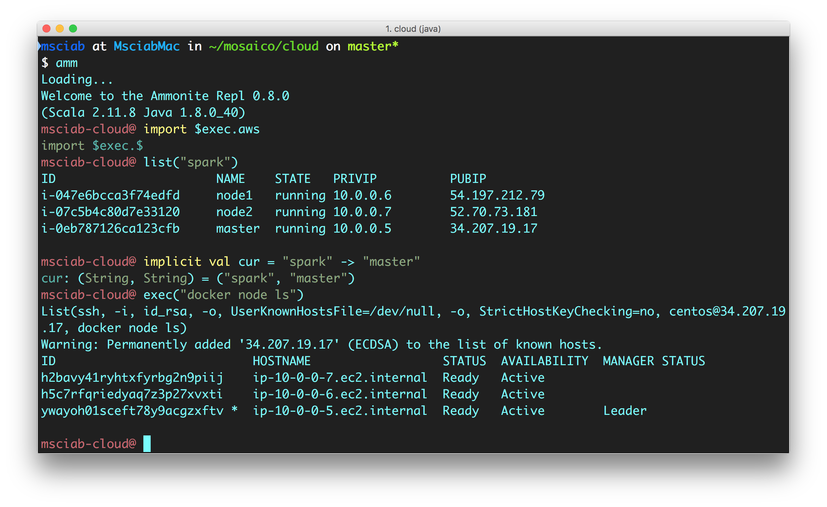
How a DevOps DevEnv Looks like

Slide 15
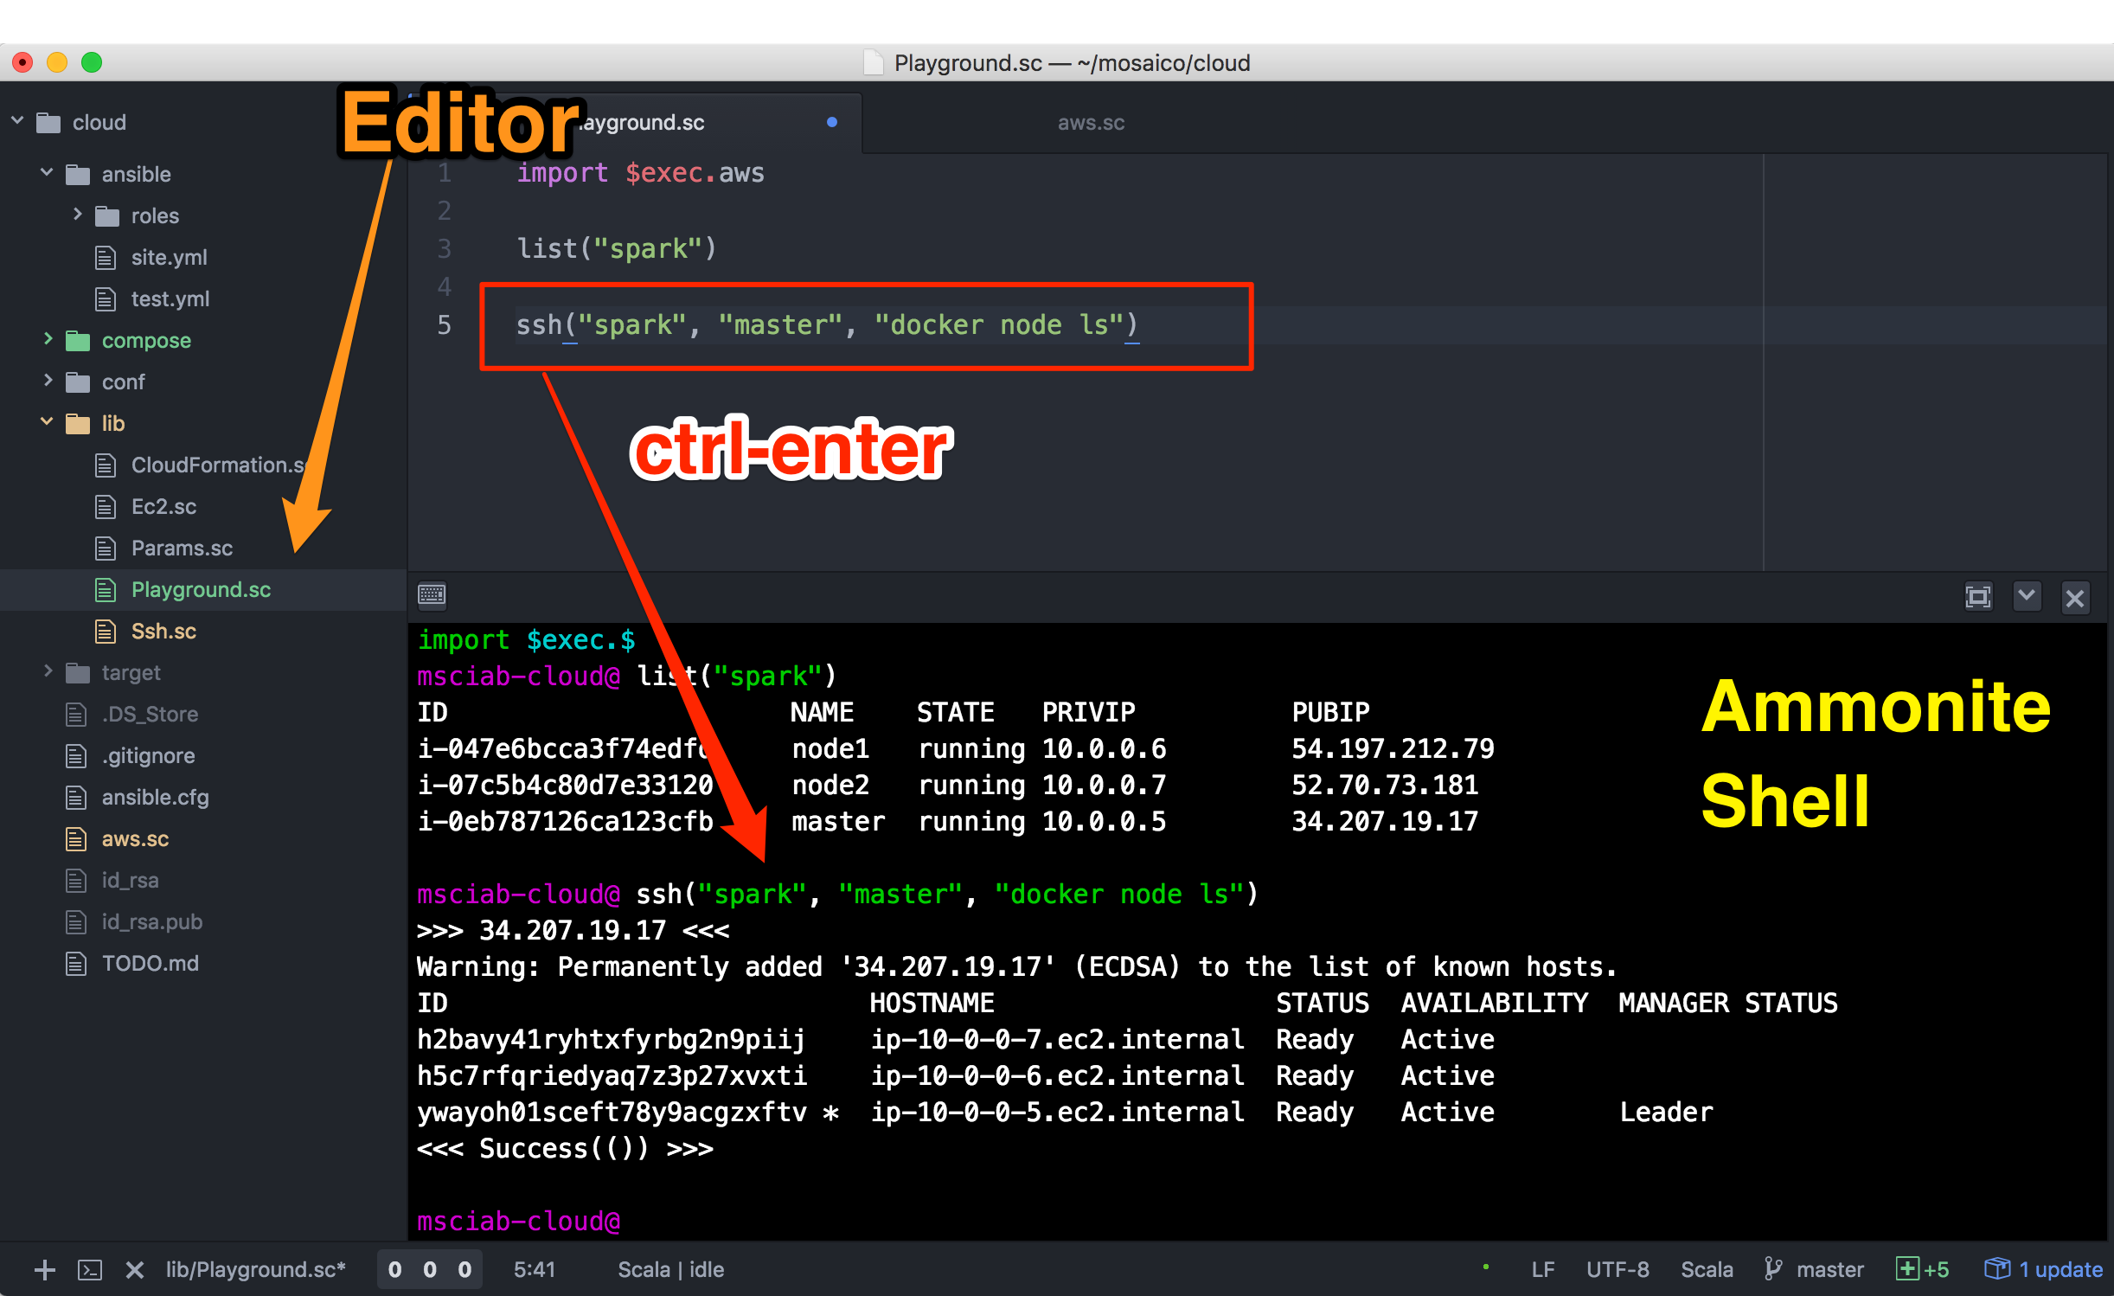
But we can do a bit better

Slide 16
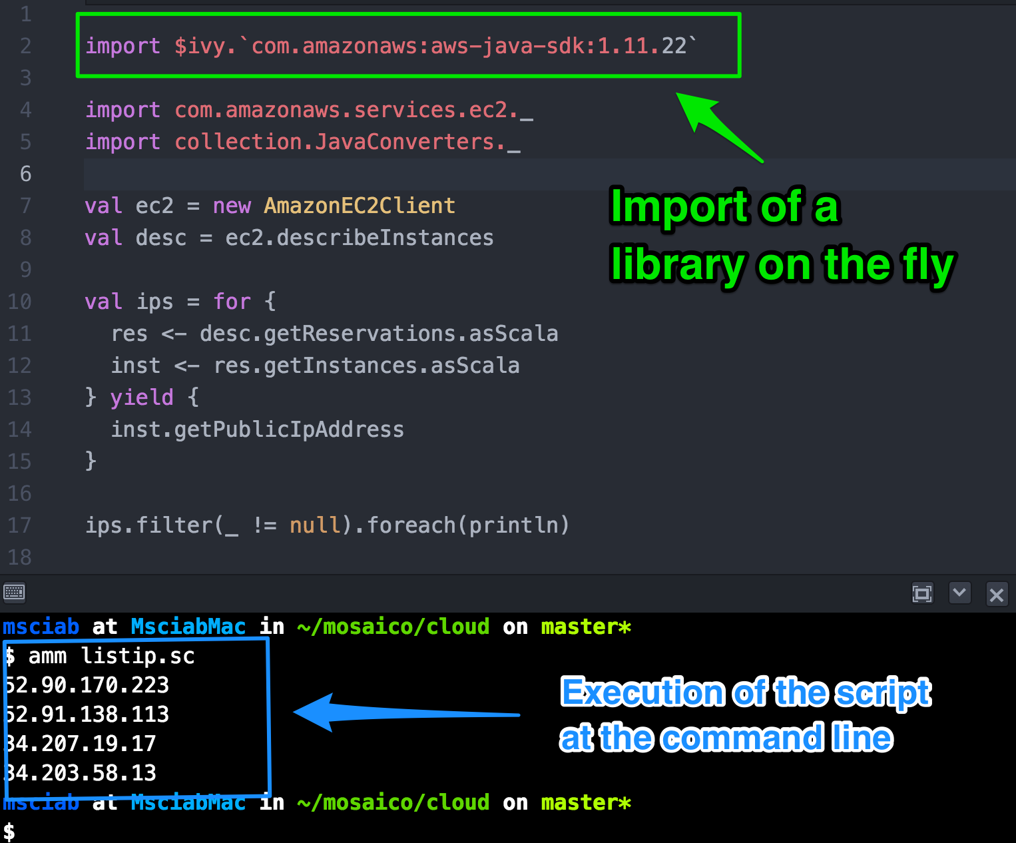
Ammonite

Slide 17
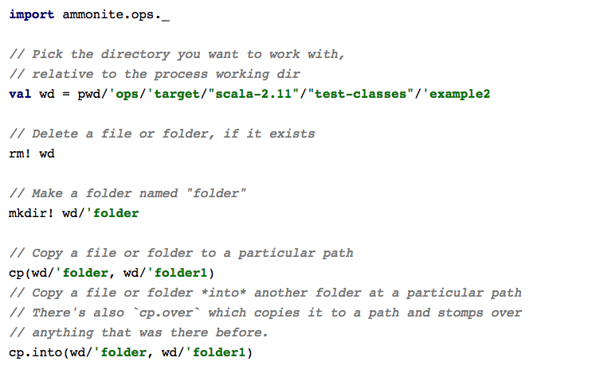
Ammonite Scripting features

Slide 18
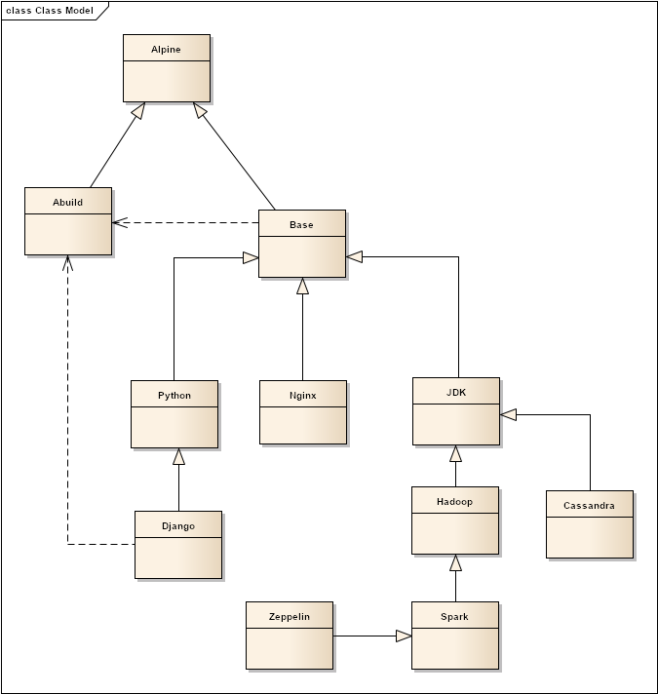
Hierarchy of Containers

Slide 19
The base Image
Built on top of Alpine Linux
an "in-memory" ultrasmall linux distro
Daemontools
provides monitoring of applications
Augeas
Configuration file helper
Serf
Provides autodiscovery and inter-container communication

Slide 20
MosaicoDocker SBT Plugin
Extends SBT-DOCKER
Model dependencies between containers
Can script Dockerfile generation in scala
External configuration files
Downloading of files before building the image
Ability to compile and build packages using other images
Smart "unpacking" of archives (removing unnesessary files)

Slide 21
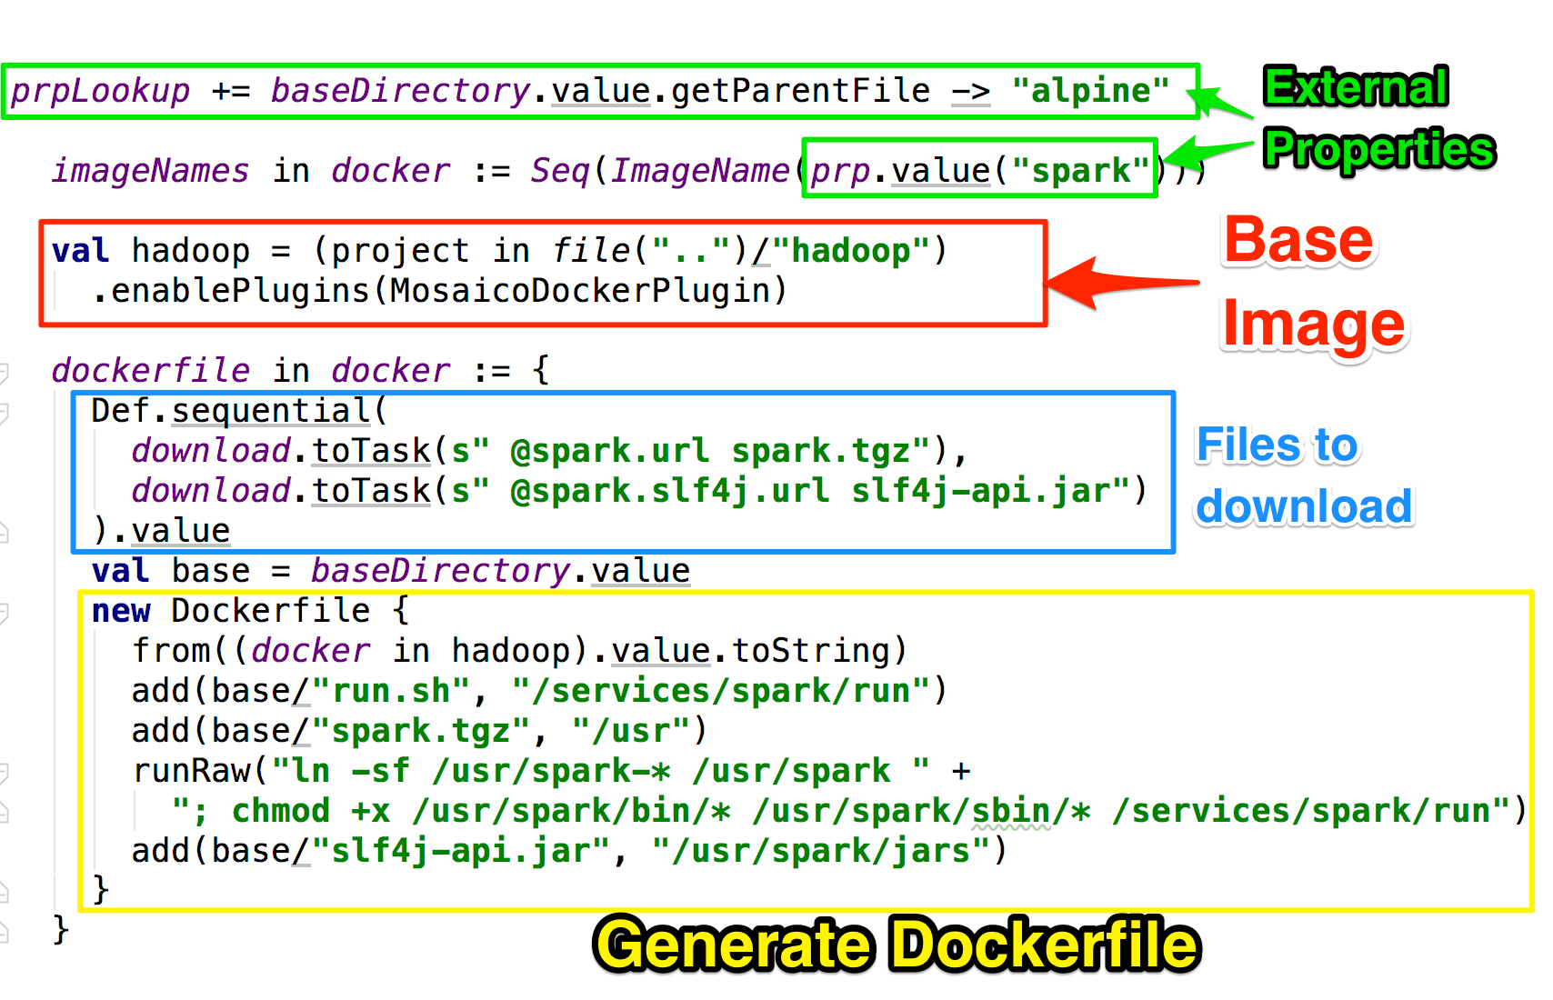
Building with SBT-DOCKER

Slide 22

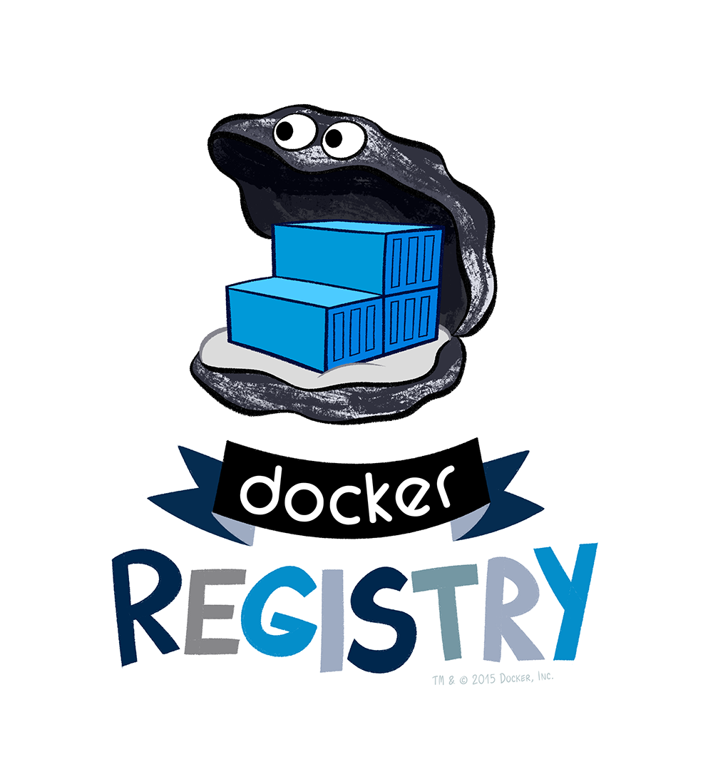

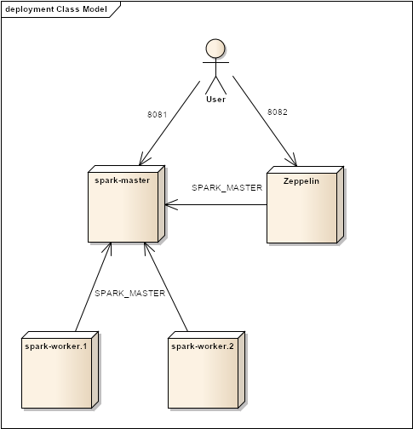
Four Steps to the Enlightment
1
2
3
4

Slide 23
Step 1: building the cloud
Ammonite
Actually: creating the VMs....

Slide 24
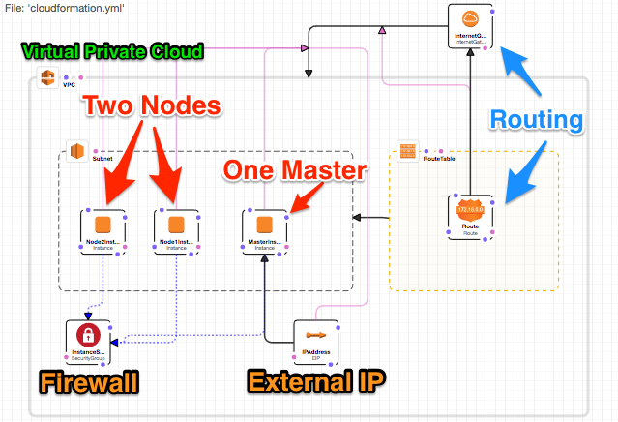
Cloud Formation

Slide 25
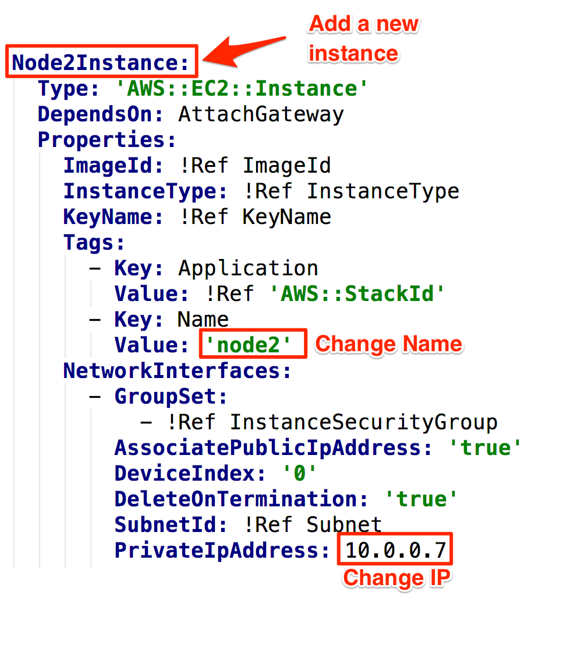
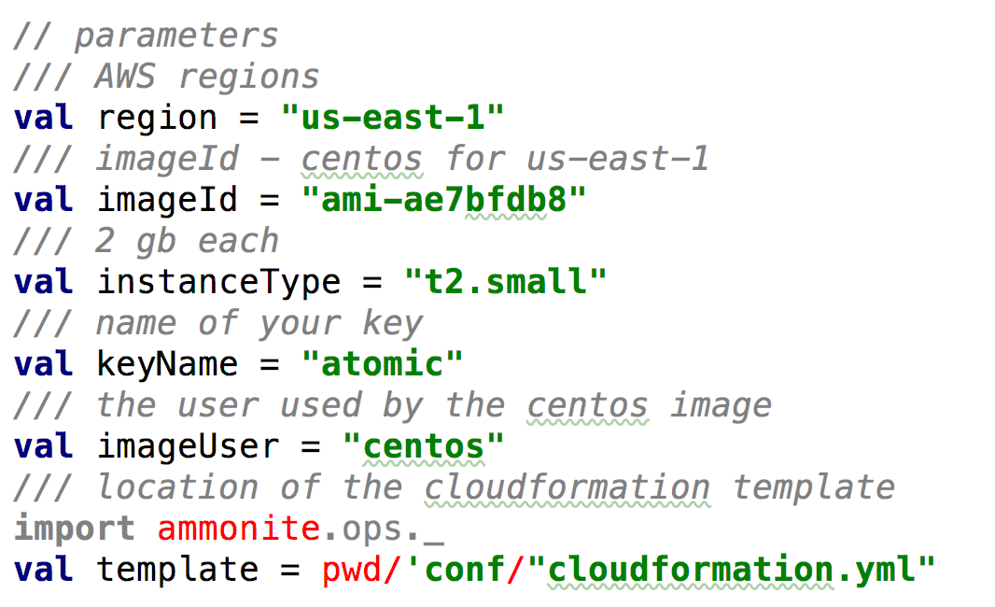
Customising cloudformation.yml
conf/cloudformation.yml
lib/Params.sc

Slide 26
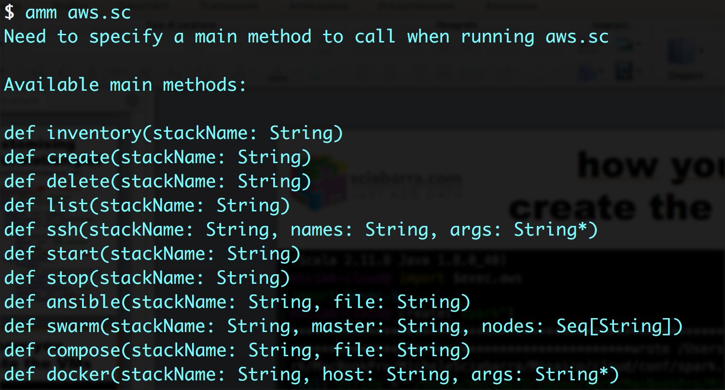
What the aws.sc script provides

Slide 27
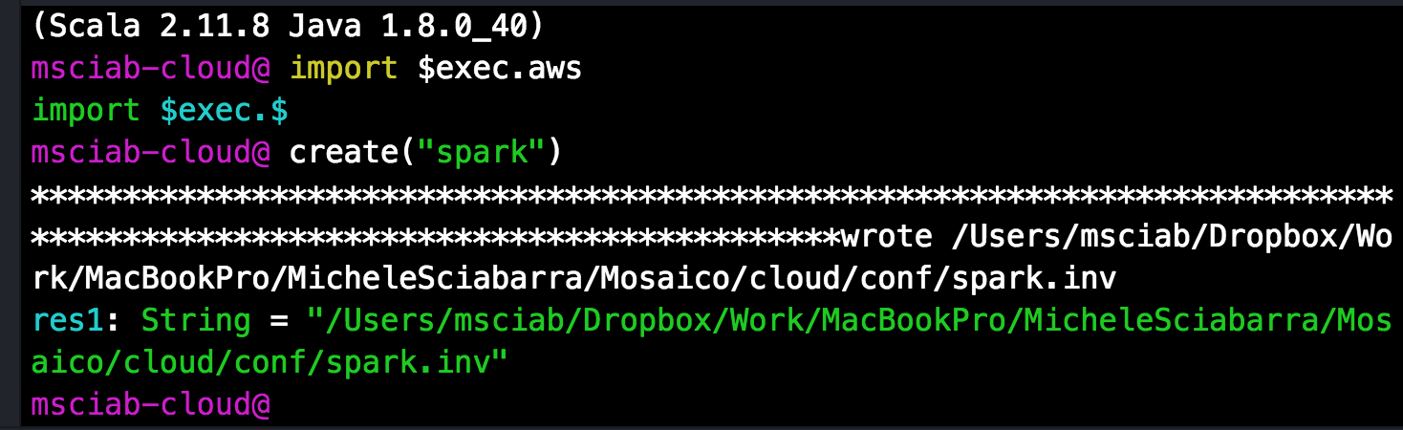
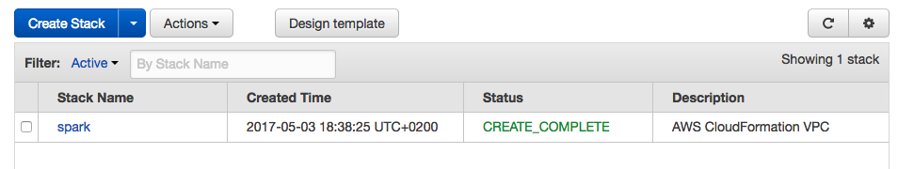
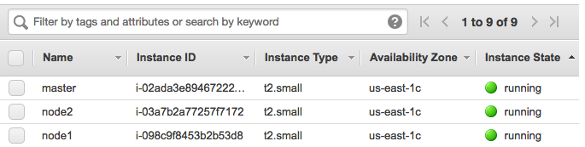
how you create the VMs

Slide 28
Step 2 Deploying Docker Swarm
Ammonite

Slide 29
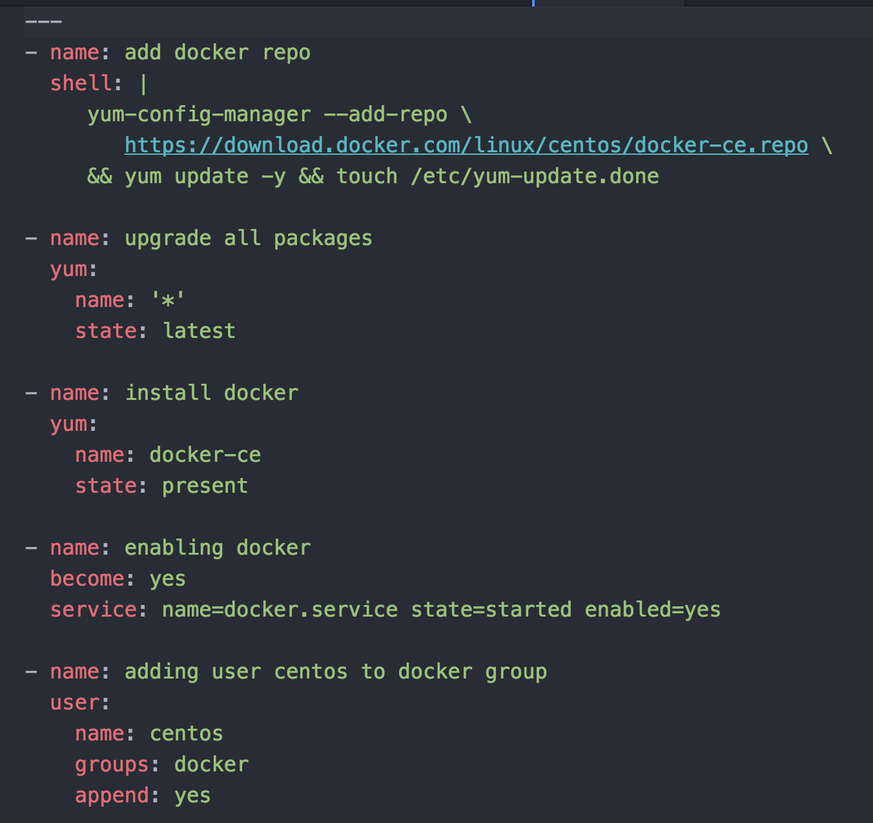
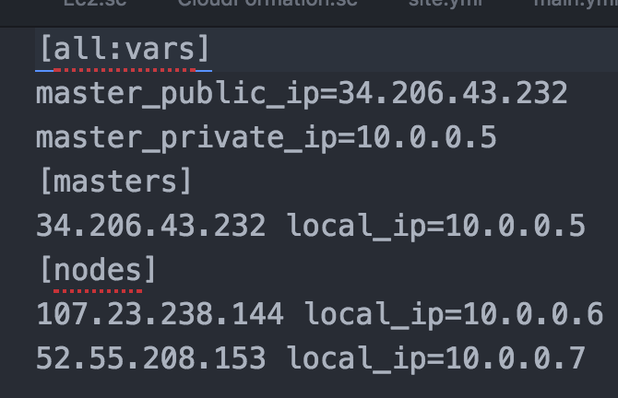
How ansible looks like
A collection of tasks
An inventory file
(generated)

Slide 30
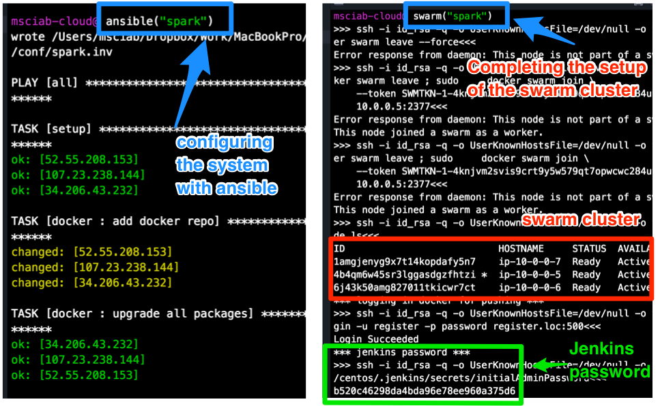
Ansible & Swarm

Slide 31
Step 3. Building Docker Images

Slide 32
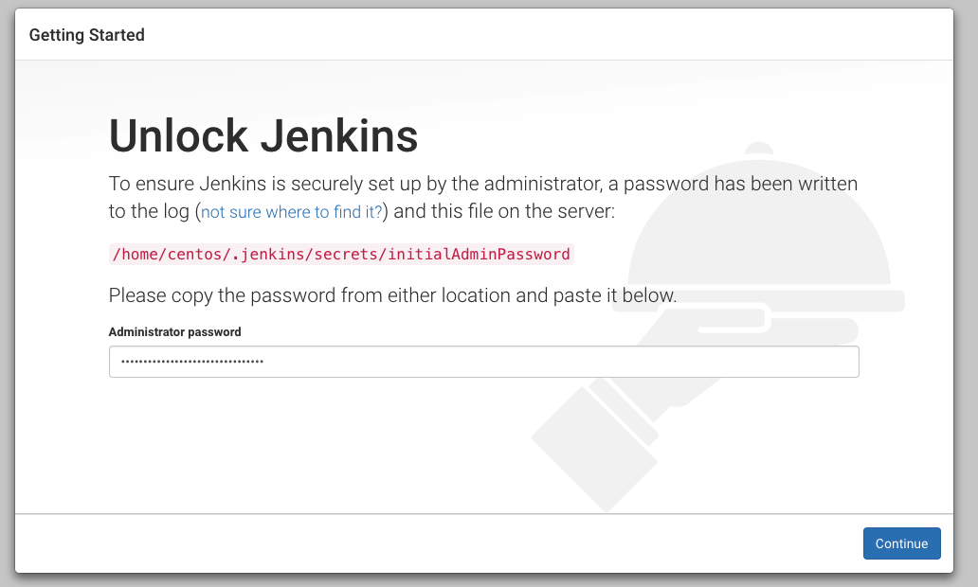
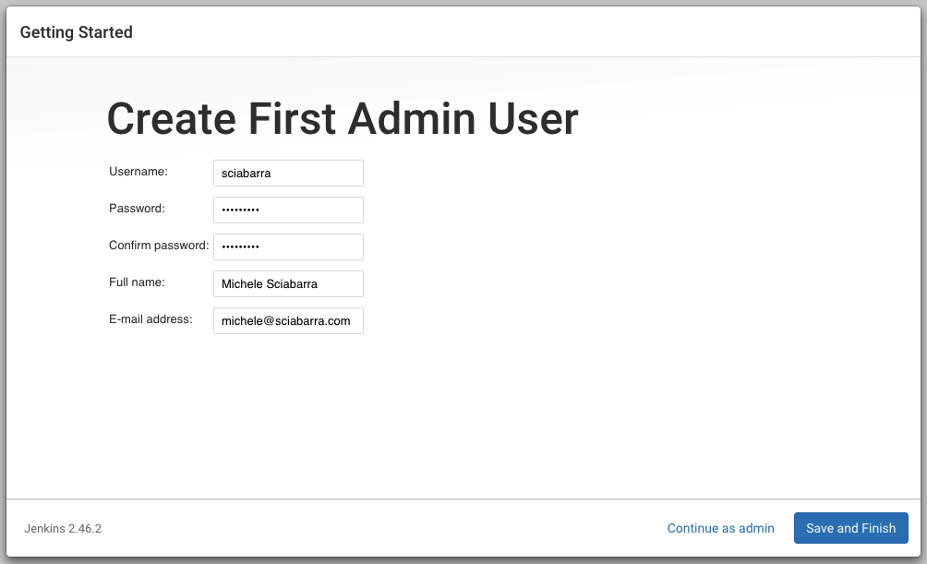
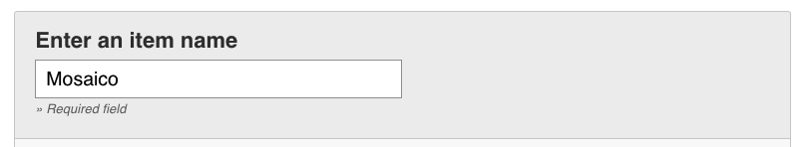
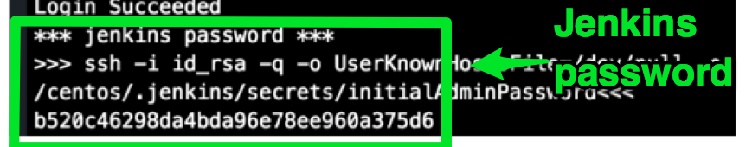
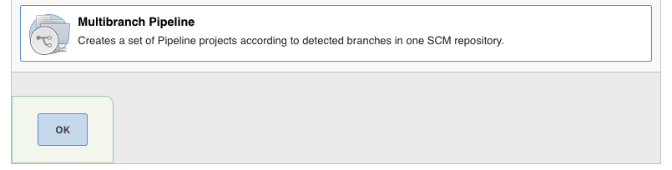
Preparing Jenkins
1
2
3

Slide 33
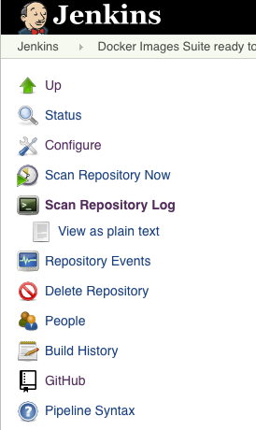
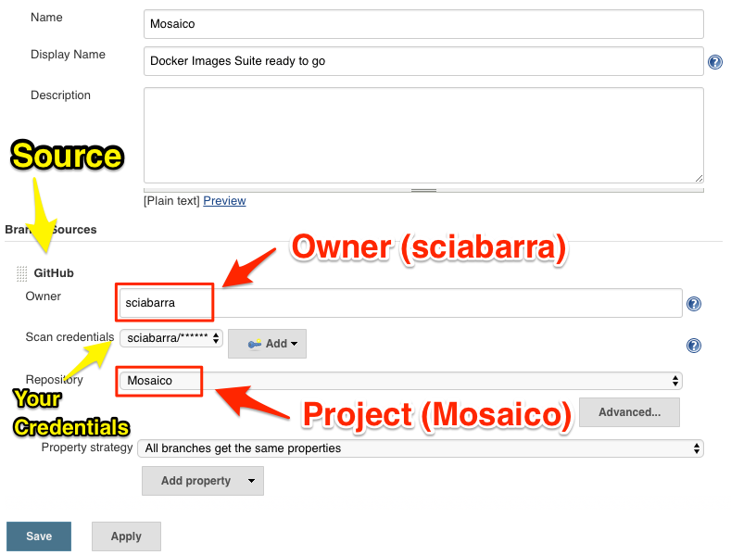
Create a Jenkins Job to build
4

Slide 34
Step 4 Orchestrate
Ammonite
Docker Compose

Slide 35
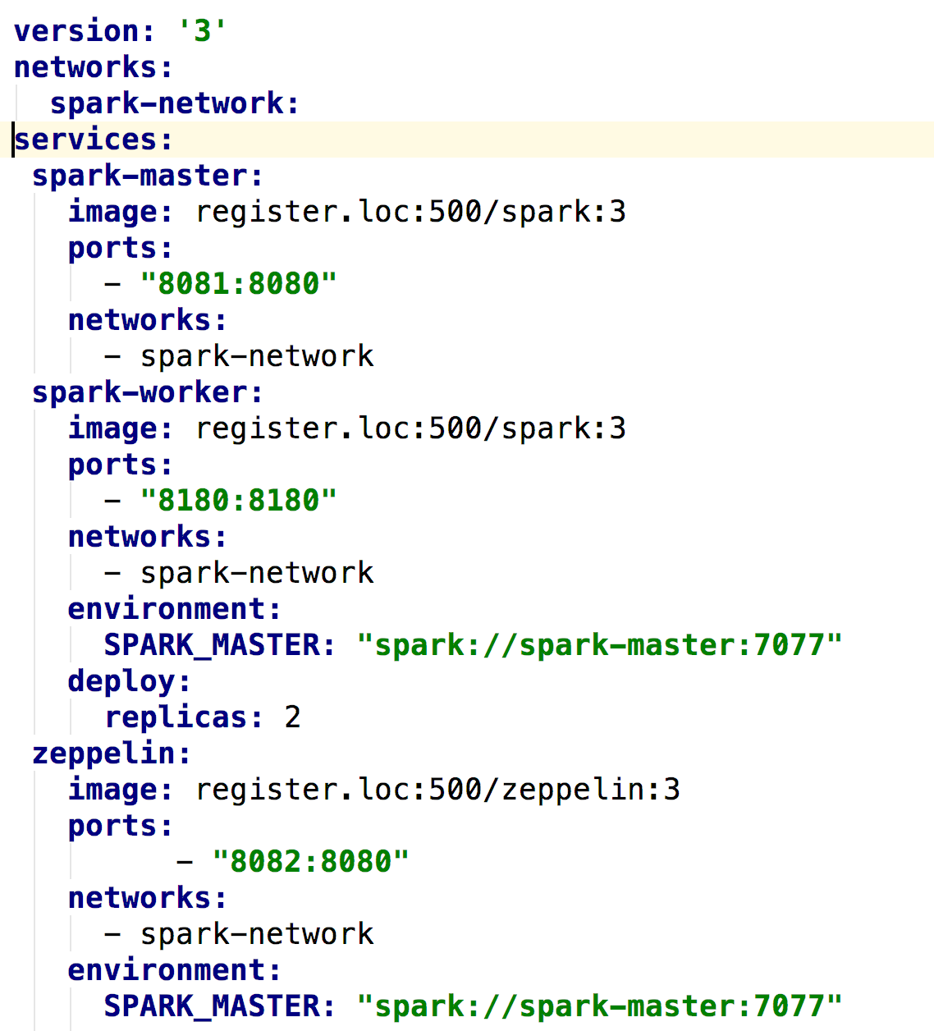
Orchestrate

